Slide 1
Bikestore analysis
File created on: 6/28/2023 7:59:40 AM

Slide 2
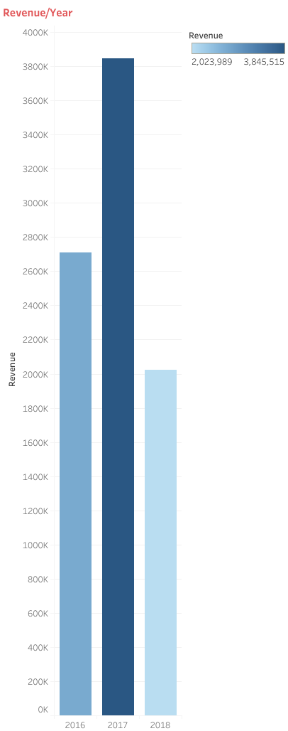

Slide 3
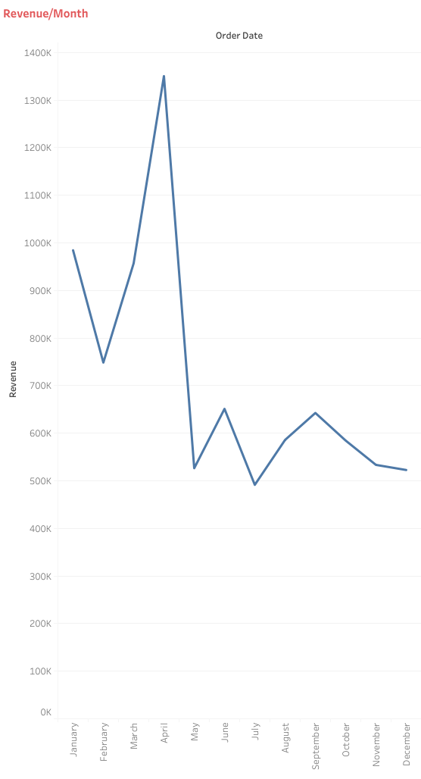

Slide 4
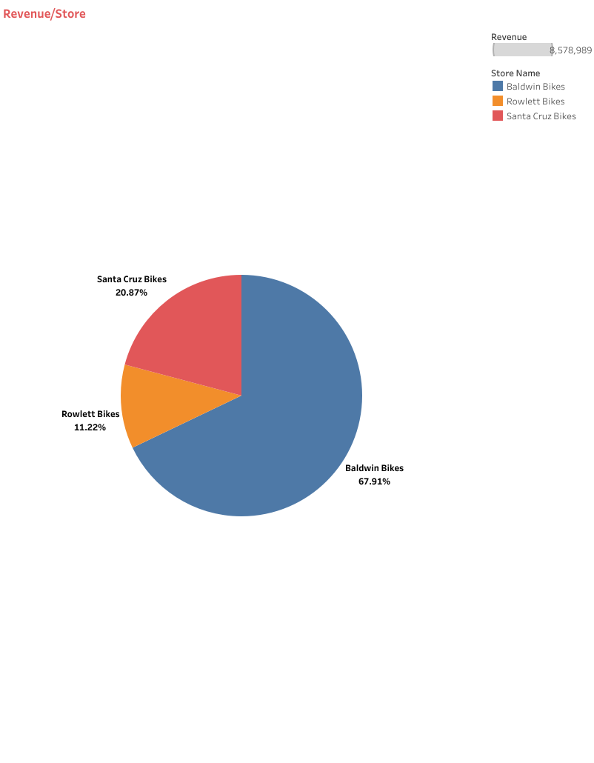

Slide 5
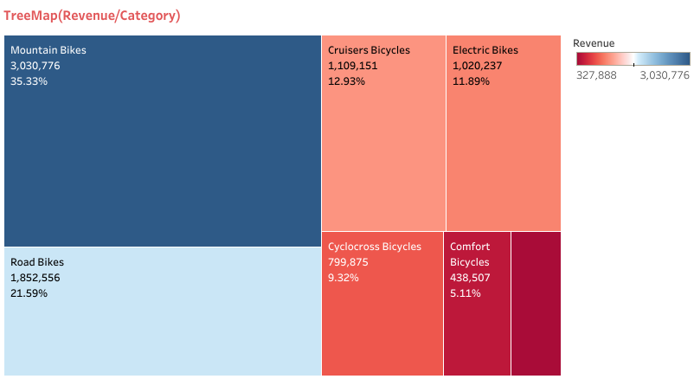

Slide 7


Slide 8
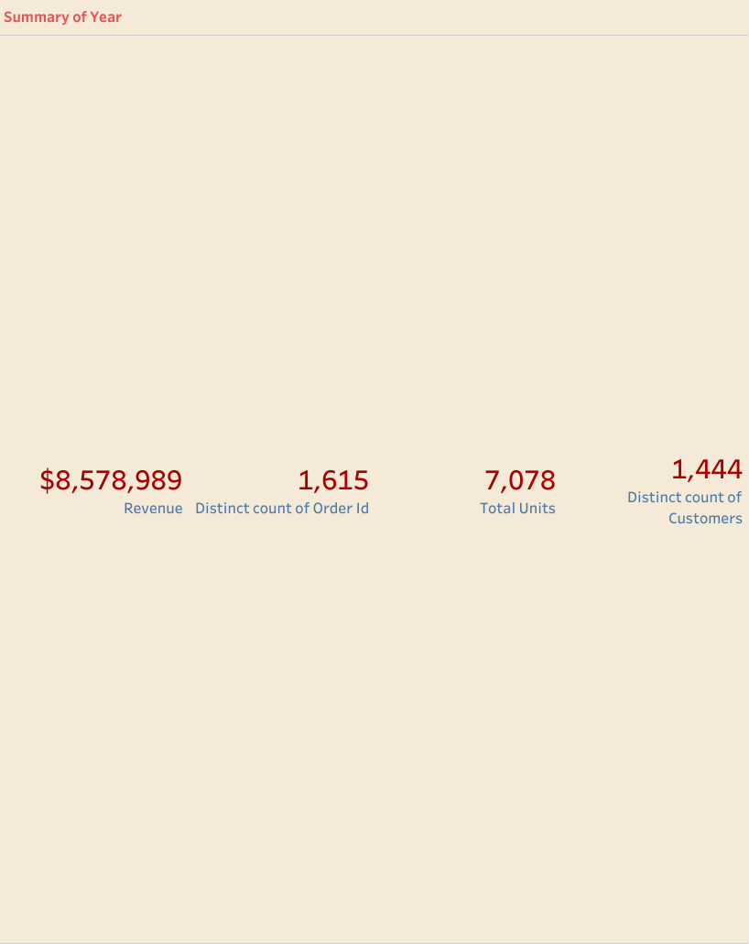

Slide 9
